Slide 1
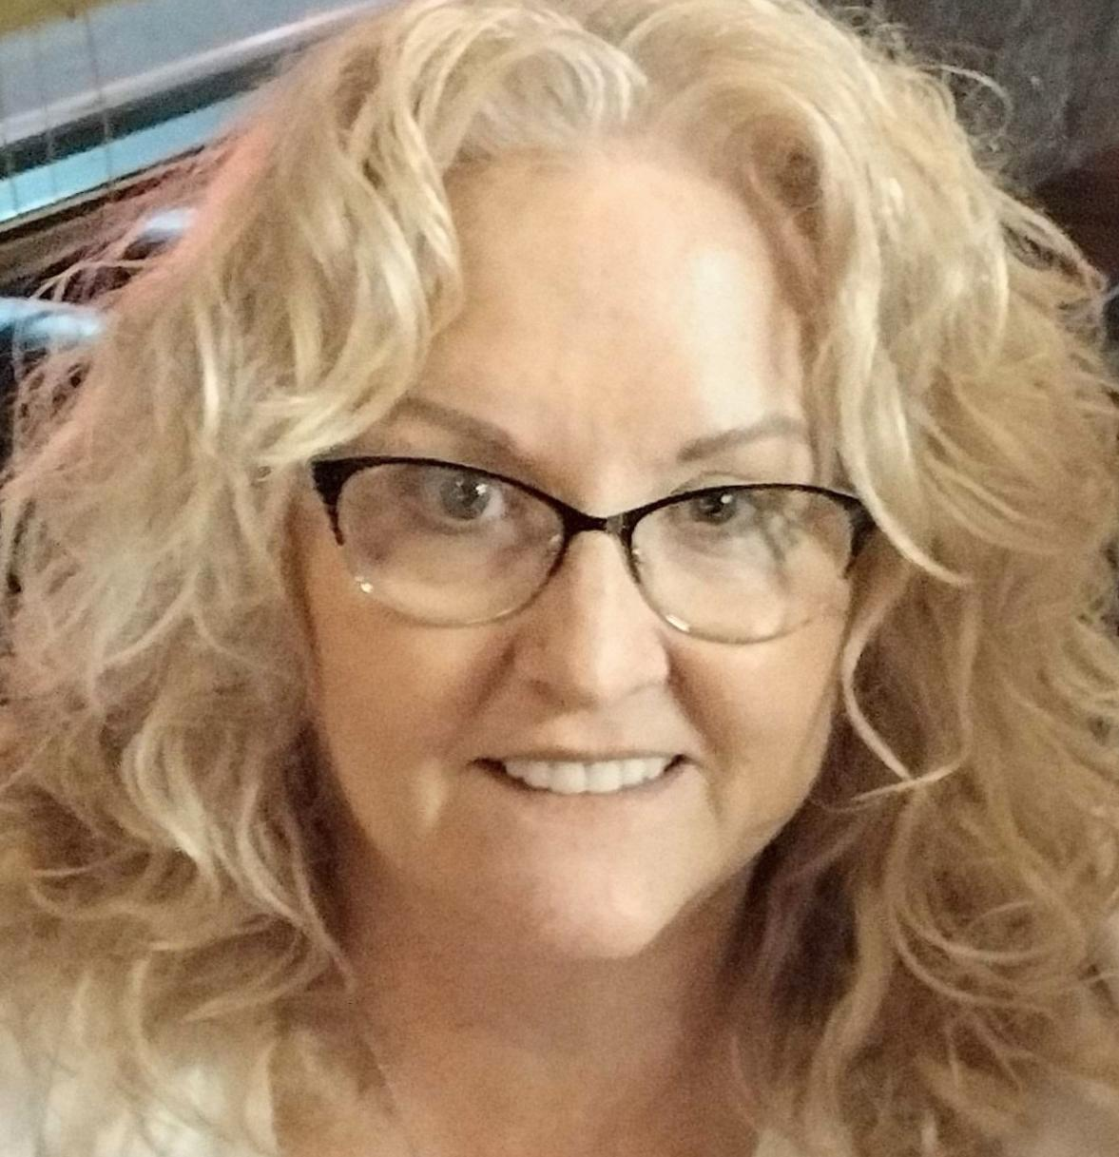
QUALITY ASSURANCE & PERFORMANCE IMPROVEMENT
QUALITY ASSURANCE & PERFORMANCE IMPROVEMENT
Laurie Allen-Omura RN, MSN, PHN, CDP
Laurie provides ongoing clinical and administrative staff education for the purpose of quality improvement. She is an experienced nurse educator, manager, and clinician. Her past roles have included Hospice Case Manager, Acute Care Clinical Manager, Nursing Director for both a Skilled Nursing Facility (SNF) and multiple Congregate Living Health Facilities (CLHFs), and Director of Patient Care Services for a Home Care Agency. Additionally, she holds a 16-year background as a theory and clinical educator in schools of vocational and registered nursing and is a Certified Dementia Practitioner. These positions have uniquely shaped her ability to utilize quality assurance data for improvement of nursing performance and patient care at Angel’s Hospice.

